Slide 1
GPU Programming
Rutgers SPS
Andrew Schwartz

Slide 2
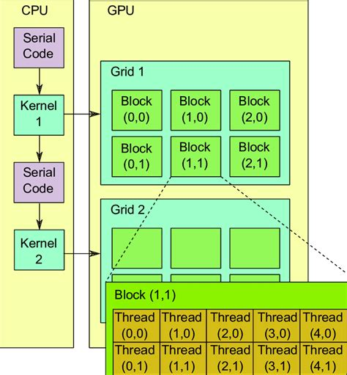
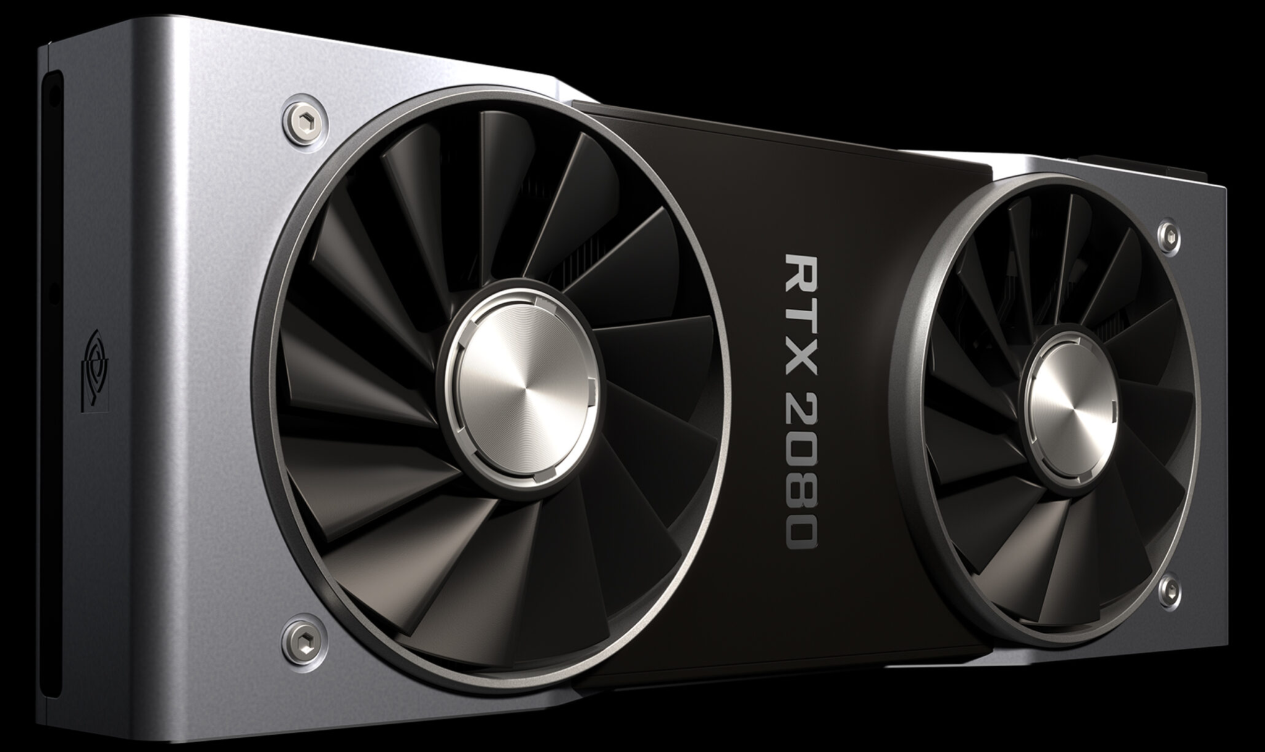
What is a GPU?
A processor designed to do many math operations at the same time
We can use it to speed up calculations and simulations

Slide 3
Today’s Exercise: Calculate π

